Slide 1
Differentially Private Access Patterns for Searchable Symmetric Encryption
Guoxing Chen†, Ten-Hwang Lai†, Michael K. Reiter‡, Yinqian Zhang†
†The Ohio State University
‡The University of North Carolina at Chapel Hill

Slide 2







Searchable Symmetric Encryption (SSE)
w1
D1
D3
wi: keyword
w2
D2
D3
D1
D2
D3
Di: document

Slide 3
Searchable Symmetric Encryption (SSE)
token
w1
w1
D1
D3
w2
D2
D3
D1
D2
D3

Slide 4

Access Pattern Leakage
Obfuscation
IKK attack[1]
Leakage abuse attack[2]
token
With a priori knowledge of the documents, e.g., keyword co-occurrence probability
w1
D1
D3
D1
D3
token
w2
D2
D3
D1
D3
An honest-but-curious server could infer the content of the searched keywords
[1] Islam et al., “Access pattern disclosure on searchable encryption: Ramification, attack and mitigation.” in NDSS, 2012.
[2] Cash et al., “Leakage-abuse attacks against searchable encryption,” in ACM CCS, 2015.

Slide 5
Outline
Access pattern obfuscation overview
d-private access patterns
Evaluation

Slide 6
Outline
Access pattern obfuscation overview
d-private access patterns
Evaluation

Slide 7
Access pattern obfuscation
w1
D1
D3
D2
Introduce false positives and false negatives to the search results
False positive: returning some document that does not contain w1, e.g., D2
False negative: not returning some document that does contain w1, e.g., D3
Correctness?

Slide 8
Correctness ?
Trade-off between correctness and privacy
Recall rate: the percentage of matching documents returned
Specify high recall rates, e.g., >99.99%
Add redundancy to achieve high recall rates

Slide 9
Erasure coding
A k out of m erasure code (k <= m):
Each document is encoded into m shards
Each shard is 1/k of the original size
Any k of the m shards are sufficient to recover the original document
Example: Reed-Solomon code

Slide 10
Access pattern obfuscation overview
w1
D11
D1
D12
D3
D13
D31
D32
D33
D3
D11
D21
D22
D23
D1
D12
D2
D13
D31
D32
D33
2 out of 3 erasure code applied

Slide 11
Access pattern obfuscation overview
w1
D11
D12
D13
D31
D32
D33
Introduce false negative(s)
Introduce false positive(s)
D11
D12
D13
D21
D22
D23
D31
D32
D33

Slide 12
Access pattern obfuscation overview
w1
D11
D21
D13
D31
D32
D11
D12
D13
D21
D22
D23
D31
D32
D33

Slide 13
Access pattern obfuscation overview
token
w1
w1
D11
D21
D13
D31
D32
2 out of 3 erasure code: any 2 shards are sufficient to recover the original document
D1
D3
D11
D12
D13
D21
D22
D23
D31
D32
D33

Slide 14
Outline
Access pattern obfuscation overview
d-private access patterns
Evaluation

Slide 15

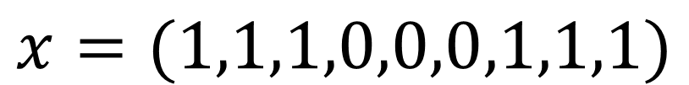
Access pattern
$$x$$
Define an access pattern as a binary vector with length n = nc × m
nc: number of documents
m: each document is encoded into m shards using k out of m erasure coding.
w1
D11
D12
D13
D31
D32
D33
D11
D12
D13
D21
D22
D23
D31
D32
D33
$$x=(1,1,1,0,0,0,1,1,1)$$

Slide 16




Obfuscation goal
Generate an obfuscated access pattern
$$y=κ\left(x\right)$$
$$κ$$
is a probabilistic function
$$x′$$
Goal: when two access patterns and are similar, the distributions of the generated obfuscated access patterns are indistinguishable.
$$x$$

Slide 17



d-privacy
Use Hamming distance to measure the similarity between two access patterns
$$d_{h}\left(x,x′\right)$$
Use d-privacy to define indistinguishability
$$\frac{Pr\left[κ\left(x\right)=y\right]}{Pr\left[κ\left(x′\right)=y\right]}≤e^{εd_{h}\left(x,x′\right)}$$
is a privacy parameter
$$ε$$

Slide 18





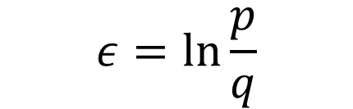




d-private obfuscation mechanism
Given
$$x=(x_{1},x_{2},x_{3},…,x_{n})$$
Generate as follows
If
Output with probability , or with probability
Else
Output with probability , or with probability
$$y=(y_{1},y_{2},y_{3},…,y_{n})$$
$$x_{i}=1$$
$$y_{i}=1$$
$$p$$
$$y_{i}=0$$
$$1−p$$
$$y_{i}=1$$
$$q$$
$$y_{i}=0$$
$$1−q$$
$$ε=\ln{\frac{p}{q}}$$
Achieve d-privacy with

Slide 19
Outline
Access pattern obfuscation overview
d-private access patterns
Evaluation

Slide 20
Implementation
We implemented a Java package to provide access pattern obfuscation support to an open source SSE library, Clusion[1].
[1] S. Kamara and T. Moataz. Clusion. https://github.com/orochi89/Clusion.

Slide 21
Evaluation: Security
Baseline IKK attack: the adversary knows the parameters in use, i.e., m, k, p, q.
Improved IKK attack: the adversary further knows which shards belong to the same document.
Use Bayesian estimation to infer the original access patterns

Slide 22
Evaluation: Performance
Storage overhead
Extra document shards
Increased index size
Communication overhead

Slide 23
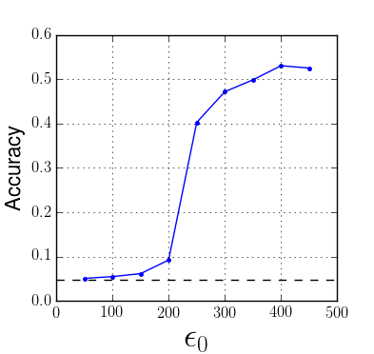
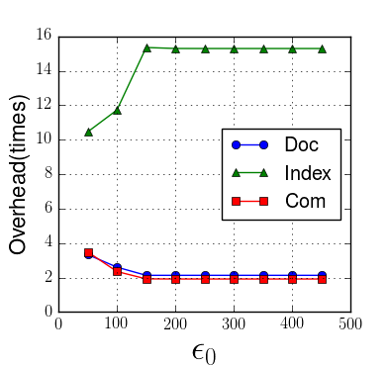
Baseline IKK attack
Baseline IKK attack accuracy, with recall > 99.9999%
Storage and communication overhead, with recall > 99.9999% (baseline IKK attack)

Slide 24
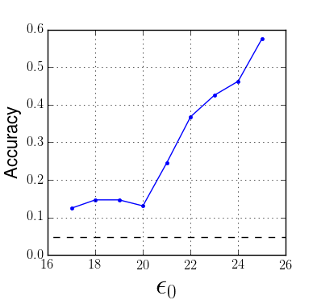
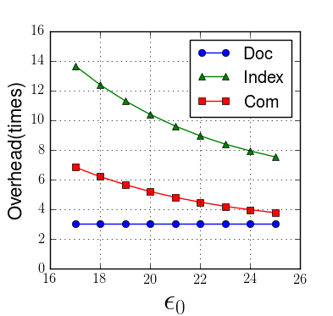
Improved IKK attack
Improved IKK attack accuracy, with recall > 99.99%
Storage and communication overhead, with recall > 99.99% (improved IKK attack)

Slide 25
Conclusion
Proposed d-private access pattern obfuscation mechanism for SSE
Implemented a prototype to support an open source SSE library
Evaluated the security and performance of the prototype

Slide 26
Thanks!
Guoxing Chen
chen.4329@osu.edu
APOSSE open source link:
https://github.com/donnod/APOSSE

